Slide 1
Digital-to-Analog
Analog-to-Digital
System Interfacing
Digital System and Experiment

Slide 2
Data Handling Systems
Both data about the physical world and control signals sent to interact with the physical world are typically "analog" or continuously varying quantities.
In order to use the power of digital electronics, one must convert from analog to digital form on the experimental measurement end and convert from digital to analog form on the control or output end of a laboratory system.

Slide 3
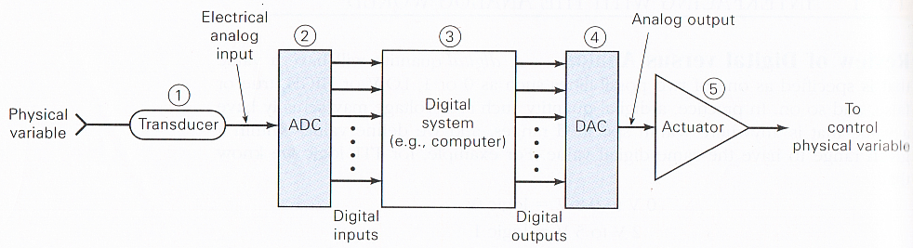
Data Collection and Control

Slide 4
Data Collection and Control
Transducer : a device that converts the physical variable to an electrical variable
Analog-to-digital converter(ADC) : converts an analog input to a digital output
Computer : stores the digital value and processes it according to a program of instructions that it is executing
Digital-to-analog converter(DAC) : converts a digital input to a proportional analog voltage or current
Actuator : The analog signal from the DAC is often connected to some device or circuit that serves as an actuator to control the physical variable.

Slide 5
Digital-to-Analog Conversion [DAC]

Slide 6
Digital-to-Analog Conversion
When data is in binary form, the 0's and 1's may be of several forms such as the TTL form where the logic zero may be a value up to 0.8 volts and the logic1 may be a voltage from 2.4 to 5 volts.
The data can be converted to clean digital form using gates which are designed to be on or off depending on the value of the incoming signal.

Slide 7
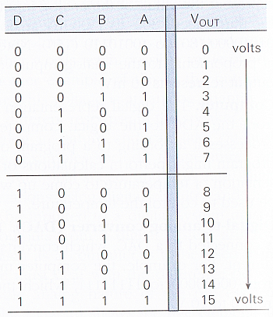
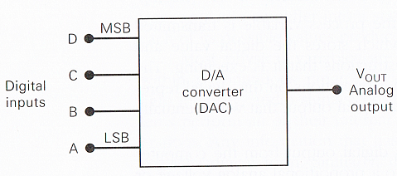
Digital-to-Analog Conversion
D/A conversion is the process of taking a value represented in digital code (such as straight binary or BCD) and converting it to a voltage or current which is proportional to the digital value.

Slide 8
Digital-to-Analog Conversion
Analog output = K * digital input
  K : the proportionality factor,
  a constant value for a given DAC
  For the DAC of Figure 10-2, K = 1 V
    V_{out} = (1V) * digital input
    digital input : 1100₂ = 12₁₀
    ➔ V_{out} = 1V*12 = 12V

Slide 9
Digital-to-Analog Conversion
Ex1> A 5-bit DAC has a current output. For a digital input of 10100, an output current of 10mA is produced. What will I_{out} be for a digital input of 11101?
  10mA = K * 20 ∴K=0.5 mA
  I_{out} = (0.5mA)*29 = 14.5mA

Slide 10
Digital-to-Analog Conversion
Analog Output
  The output of a DAC is technically not an analog quantity because it can take on only specific values like the 16 possible voltage levels for V_{out} in figure 10-2.
  The DAC output is a “pseudo-analog” quantity.

Slide 11
Digital-to-Analog Conversion
Input weights
  The contributions of each digital input are weighted according to their position in the binary number
  A(LSB) : a weight of 1V
  B : a weight of 2V
  C : a weight of 4 V
  D(MSB) : a weight of 8V
  The weights are successively doubled for each bit, beginning with the LSB.
D | C | B | A | V_{out}(V)
0 | 0 | 0 | 1 | 1
0 | 0 | 1 | 0 | 2
0 | 1 | 0 | 0 | 4
1 | 0 | 0 | 0 | 8

Slide 12
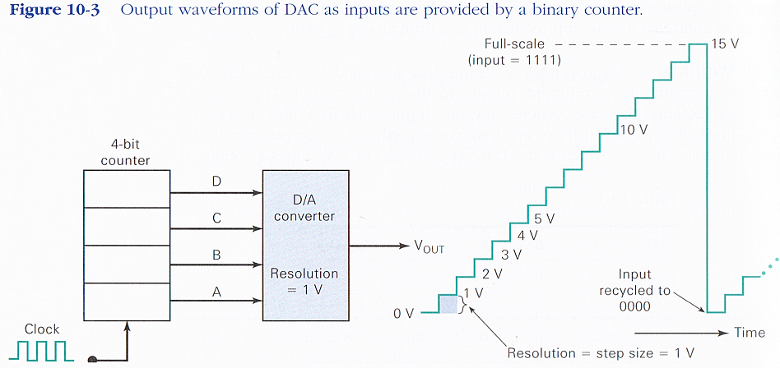
Digital-to-Analog Conversion
Resolution (Step size) : The smallest change that can occur in the analog output as a result of a change in the digital input
  The resolution is always equal to the weight of the LSB .

Slide 13
Digital-to-Analog Conversion
Ex2> A 5-bit D/A converter produces V_{out}=0.2V for a digital input of 00001. Find the value of V_{out} for an input of 11111.
  0.2V : the weight of the LSB
  Thus, the weights of the other bits : 0.4V, 0.8V, 1.6V, 3.2V
  V_{out} = 3.2V+1.6V+0.8V+0.4V+0.2V = 6.2V

Slide 14
Digital-to-Analog Conversion
Ex3> What is the resolution of the DAC of Ex2? Describe the staircase signal out of this DAC.
  Resolution = weight ∴0.2V
  A staircase waveform can be generated by connecting a 5-bit counter to the DAC input.
  The staircase will have 32levels from 0V up to a full-scale output of 6.2V, and 31 steps of 0.2V each.

Slide 15
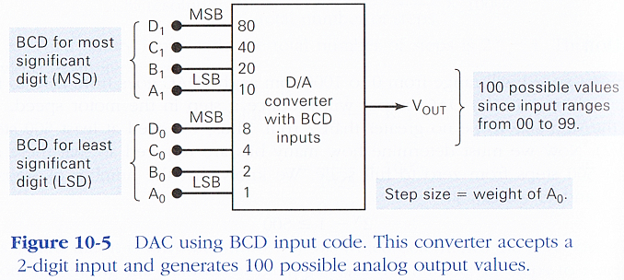
Digital-to-Analog Conversion
BCD input code
  BCD code for MSD have a relative weight that is 10 times that of the corresponding bits of the LSD.

Slide 16
Digital-to-Analog Conversion
D/A converter circuitry
  2 Basic Approaches
    Weighted Summing Amplifier
    R-2R Network Approach

Slide 17
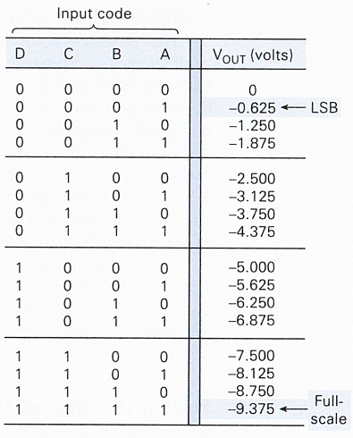
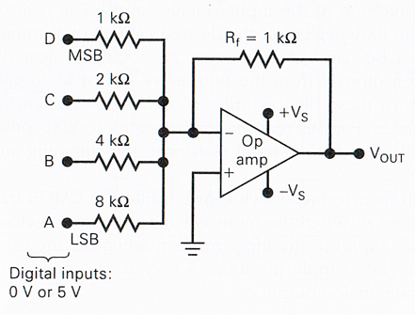

Digital-to-Analog Conversion
Weighted Summing Amplifier

Slide 18
Digital-to-Analog Conversion
Ex4>
(a) Determine the weight of each input bit of Figure 10-6.
(b) Change R_{f} to 250Ω and determine the full-scale output.
  (a)The MSB passes with gain = 1.
    So its weight in the output is 5V.
    ∴ MSB : 5V, 2nd MSB : 2.5V,
    3rd MSB : 1.25V, LSB : 0.625V
  (b)If R_{f} is reduced by a factor of 4, each input weight will be four times smaller than the values above.
    ∴ full scale output = -9.375/4 = -2.344V

Slide 19
Digital-to-Analog Conversion
Conversion Accuracy
  The table in Figure10-6 gives the ideal values of V_{out} for the various input cases.
  How close the circuit comes to producing these values depends primarily on two factors.
    The precision of input and feed back resistors
      Can be made very accurate
    The precision of input voltage levels
      Not precise values but vary within given ranges

Slide 20
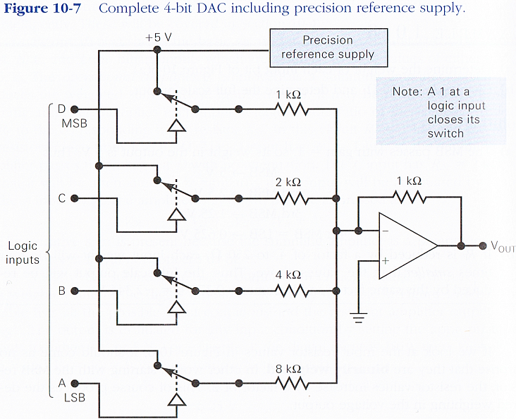
Digital-to-Analog Conversion
Each digital input controls a semiconductor switch like the CMOS transmission gate.

Slide 21
Digital-to-Analog Conversion
R/2R Ladder
  One way to achieve D/A conversion is to use a summing amplifier.
  This approach is not satisfactory for a large number of bits because it requires too much precision in the summing resistors.
  The biggest problem is the large difference in resistor values between the LSB and MSB.
    For example, if the MSB resistor is 1kΩ in a 12-bit DAC, the LSB resistor will be over 2MΩ. Is it possible?
    With the current IC fabrication technology, it is very difficult to produce resistance values over a wide resistance range that maintain an accurate ratio especially with variations in temperature.
  This problem is overcome in the R-2R network DAC.

Slide 22
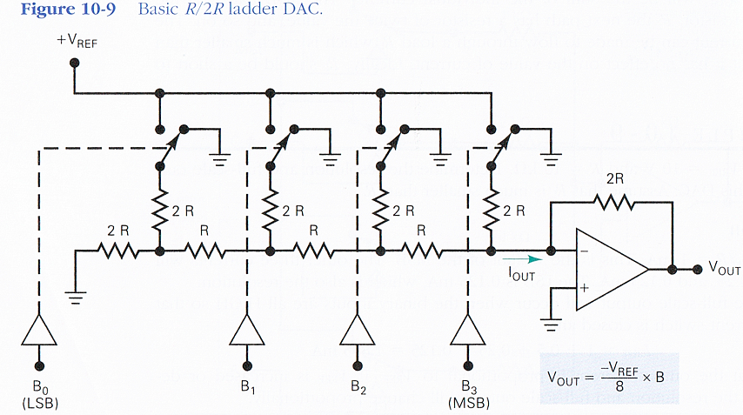
Digital-to-Analog Conversion

Slide 23
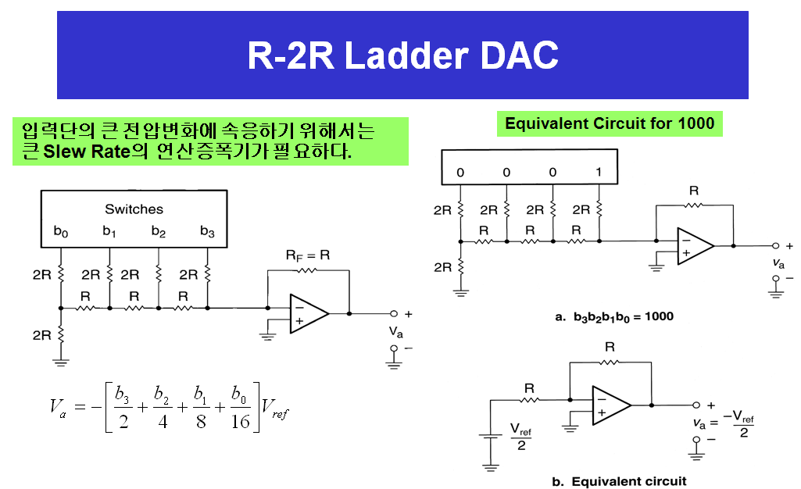

Slide 24
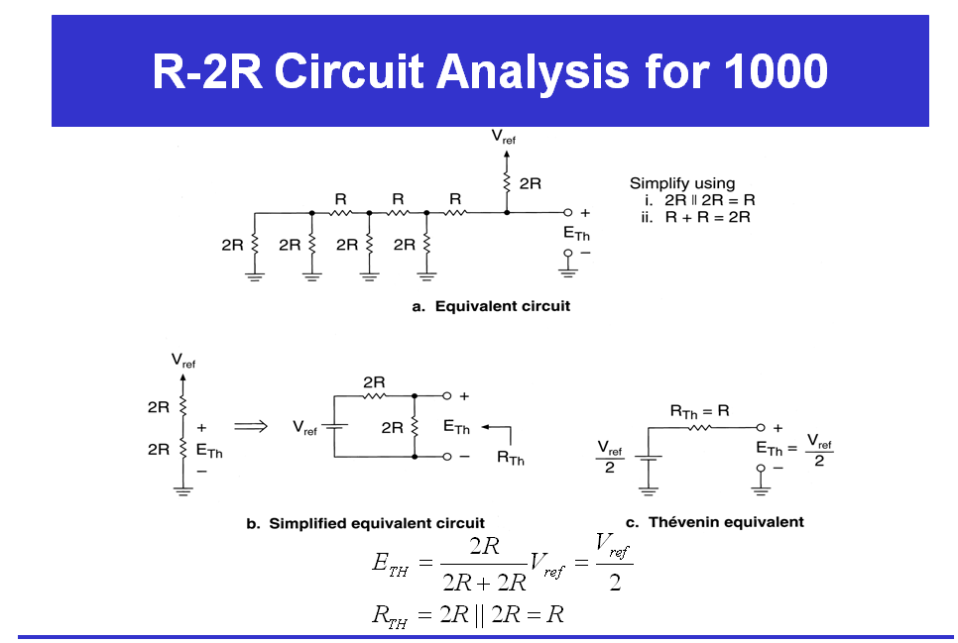

Slide 25
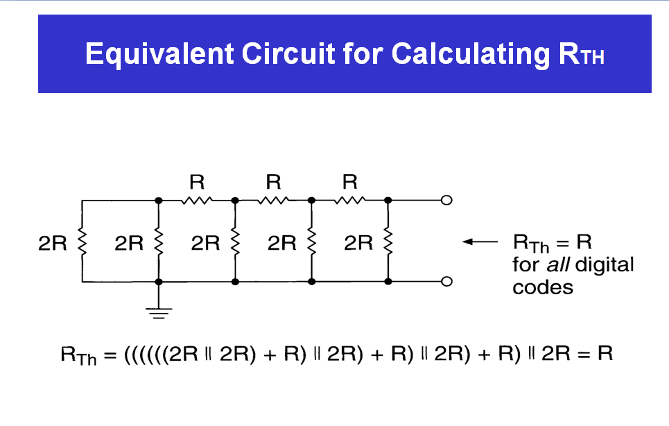

Slide 26
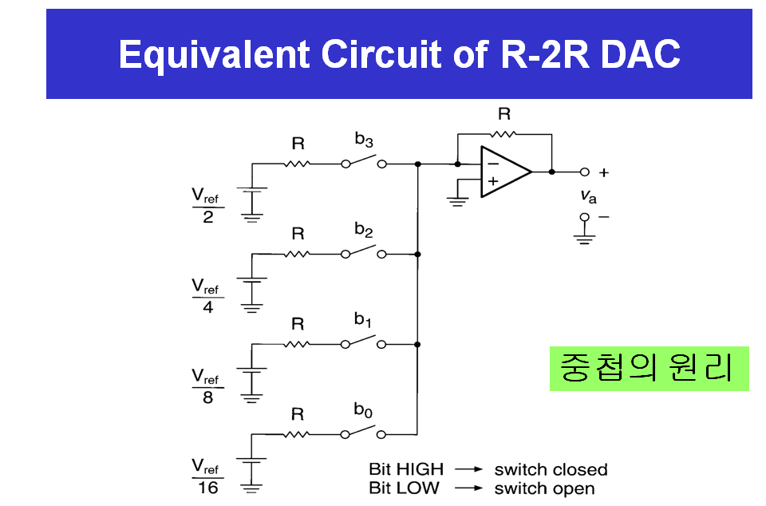

Slide 27
Digital-to-Analog Conversion
Ex5> Assume that V_{REF} = 5V for the DAC in Figure 10-9. What are the resolution and full-scale output of this converter?
  the resolution = the weight of the LSB
    B = 0001 = 1,
    ∴ resolution = -5V * 1 / 8 = -0.625 V
  The full-scale output occur
    B = 1111 =15,
    ∴ full-scale = 15V * 15 / 8 = -9.375V

Slide 28
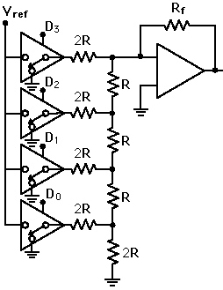

Digital-to-Analog Conversion

Slide 29
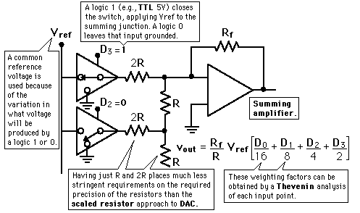
Digital-to-Analog Conversion

Slide 30
Digital-to-Analog Conversion
The summing amplifier with the R-2R ladder of resistances shown produces the output where the D's take the value 0 or 1.
The digital inputs could be TTL voltages which close the switches on a logical 1 and leave it grounded for a logical 0.
This is illustrated for 4 bits, but can be extended to any number with just the resistance values R and 2R.

Slide 31
DAC0830/DAC0832
8-Bit µP Compatible DAC
An advanced CMOS/Si-Cr 8-bit multiplying DAC designed to interface directly with the 8080, 8048, 8085, Z80®, and other popular microprocessors.
A deposited silicon-chromium R-2R resistor ladder network divides the reference current and provides the circuit with excellent temperature tracking characteristics (0.05% of Full Scale Range maximum linearity error over temperature).

Slide 32
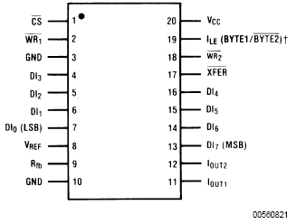
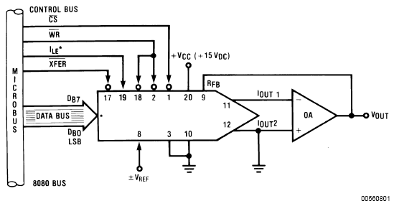
Typical Application

